Slide 1
Generative Adversarial Nets (GAN)

Slide 2
Outline
Introduction of GAN
Introduction of CGAN
Rationale of how GAN works
Simulation results
VaR and ES application for market risk
Macroeconomic time series simulation application

Slide 3
Introduction of Generative Adversarial Networks (GAN)
GAN is a generative model built by neural networks for the generation of realistic samples.
Discriminative vs. Generative models
Discriminative models learn the (hard or soft) boundary between classes: P(Y|X), logistic regression, SVM.
Generative models model the distribution of individual classes: P(X), Copula, AR, GARCH.
Literature Review
GAN was first introduced in 2014 by a group of researchers at the University of Montreal lead by Ian Goodfellow (now at OpenAI).
2019 NVIDIA, GAN 2.0: https://www.thispersondoesnotexist.com/
Wasserstein GAN (WGAN): Martin Arjovsky, Soumith Chintala, and Leon Bottou1,Courant Institute of Mathematical Sciences, Facebook AI Research. 2017.
A Large-Scale Study of GAN and its variants by Google Brain in 2018.
Time Series Simulation by Conditional Generative Adversarial Net by R. Fu, J. Chen, S. Zeng, Y. Zhuang and A. Sudjianto (2019) https://papers.ssrn.com/sol3/papers.cfm?abstract_id=3373730,
GAN for Financial Trading Strategies by Koshiyama et al. 2019.
Time-series Generative Adversarial Networks by Yoon et al. 2019.

Slide 4
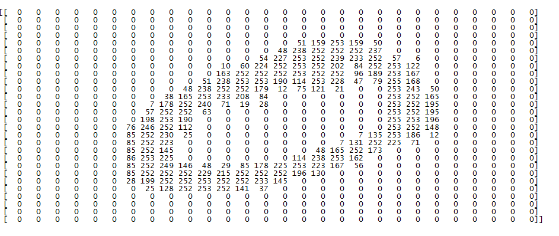
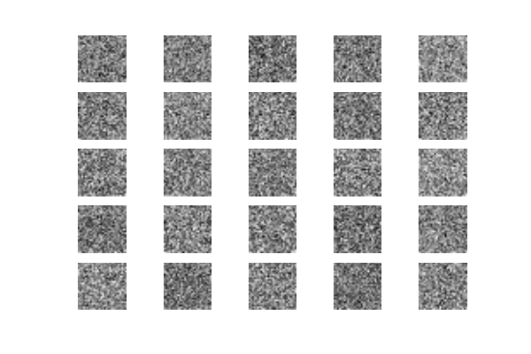
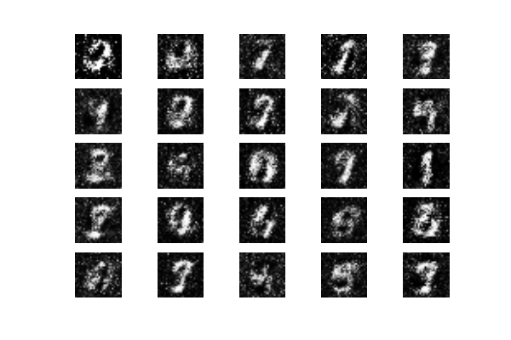
Application on Image Data
Image data format: Sample_size * img_row * img_col
Simulated image data: step 0 to step 900

Slide 5
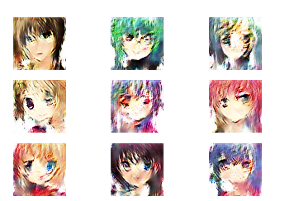
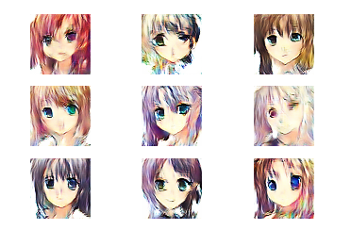
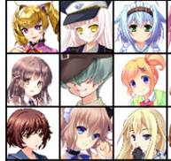
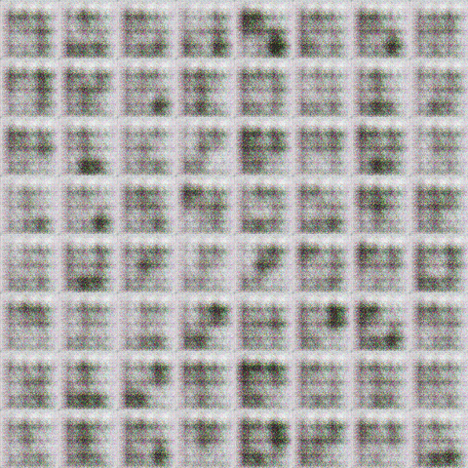
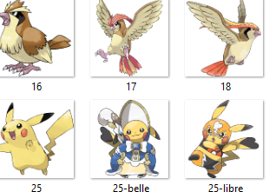

Application on Image Data
Training data
1000 iteration
5000 iteration

Slide 6
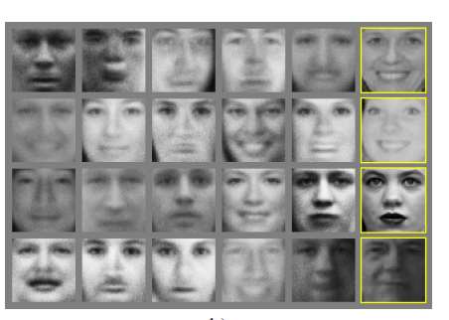
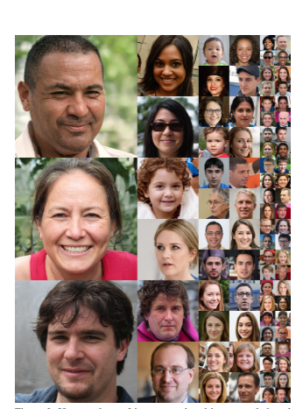
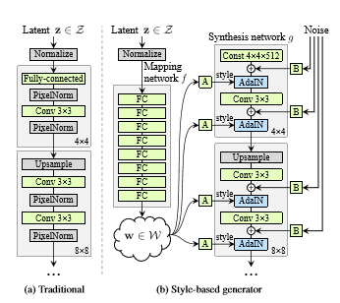
Application on Image Data
GAN 1.0
GAN 2.0: This person does not exits by GAN 2.0: https://www.thispersondoesnotexist.com/

Slide 7
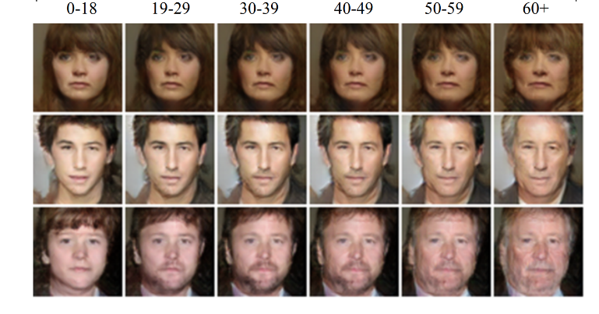
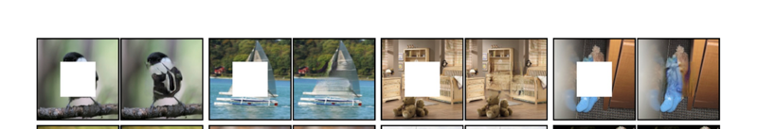
Application on Image Data
Face aging
Image painting

Slide 8
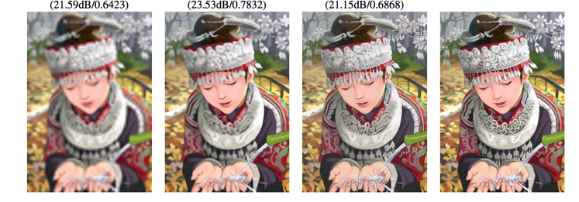
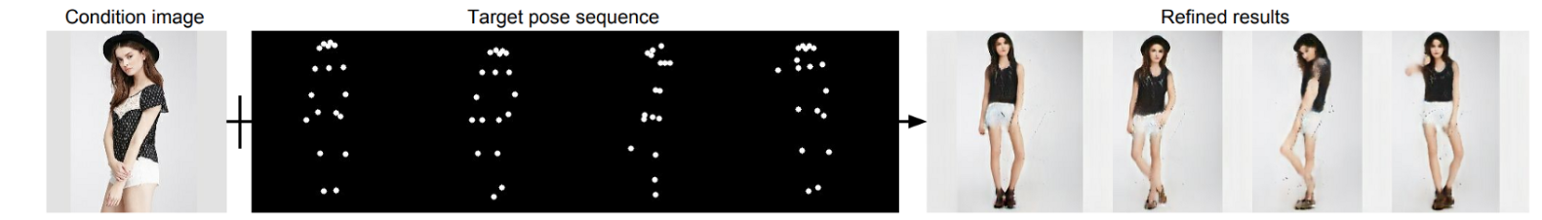
Application on Image Data
Super resolution
Pose Guided Person Image Generation

Slide 9
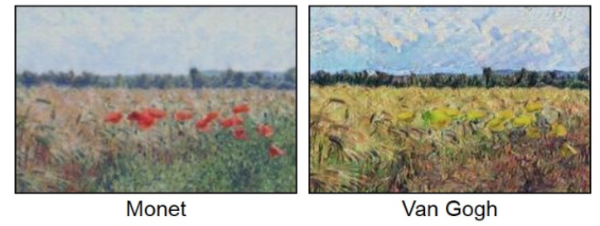
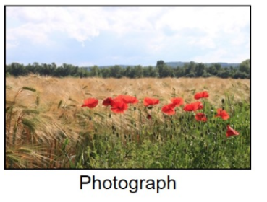
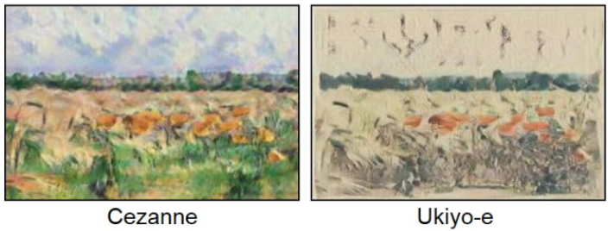
Application on Image Data
Cycle GAN

Slide 10
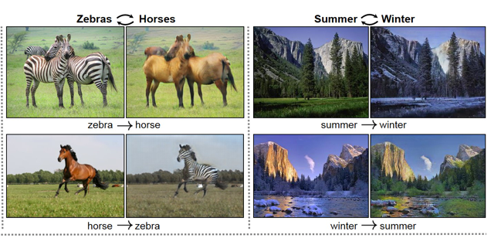
Application on Image Data
Cycle GAN: transform pictures between zebras and horses, and changing of seasons.

Slide 11
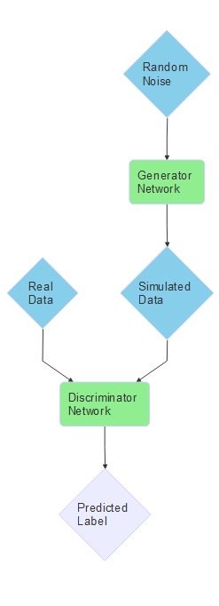
Introduction of GAN - Framework
GAN training is a minmax game on a cost function between generator (G) and discriminator (D), where both G and D are neutral network models.
$$\min_{G}{\max_{D} V\left(G,D\right)={E_{x\sim p_{data}}[log{D(x)}]}}{+E_{z\sim p_{z}}[log{(1−D\left(G(z\right))}], }$$
D outputs the probability that a sample came from the training data rather than G.
D is trained to maximize the probability of assigning the correct label to both training samples and samples from G over all real data instances and all random inputs to G (the meaning of loss function V).
G learns to generate samples that have a low probability of being fake.
Both D and G are trained simultaneously. The training stops when D and G achieve the Nash equilibrium, where none of them can be further improved through training. The Global Optimality of $p_{g}$= $p_{data}$.

Slide 12
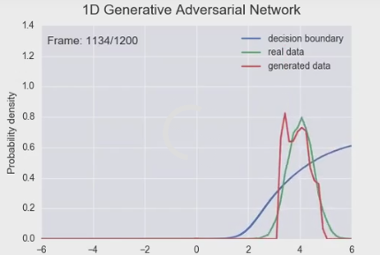
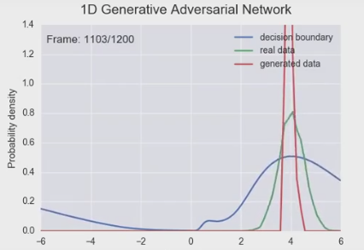
GAN
Issues with GAN:
mode collapse issue : the generator collapses to a parameter setting where it always generates a small range of outputs
Diminished gradient issue: discriminator gets too successful that the generator gradients vanish and the generator learns nothing.
Solution
WGAN (Wasserstein GAN)--a new cost function using Wasserstein distance
DRAGAN--a gradient penalty directly to GAN
GAN
WGAN

Slide 13
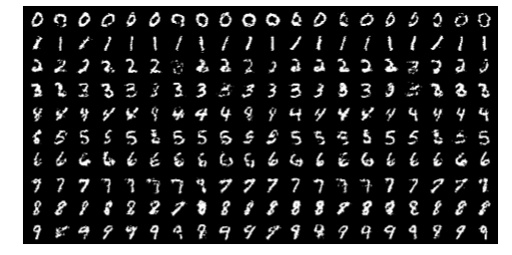
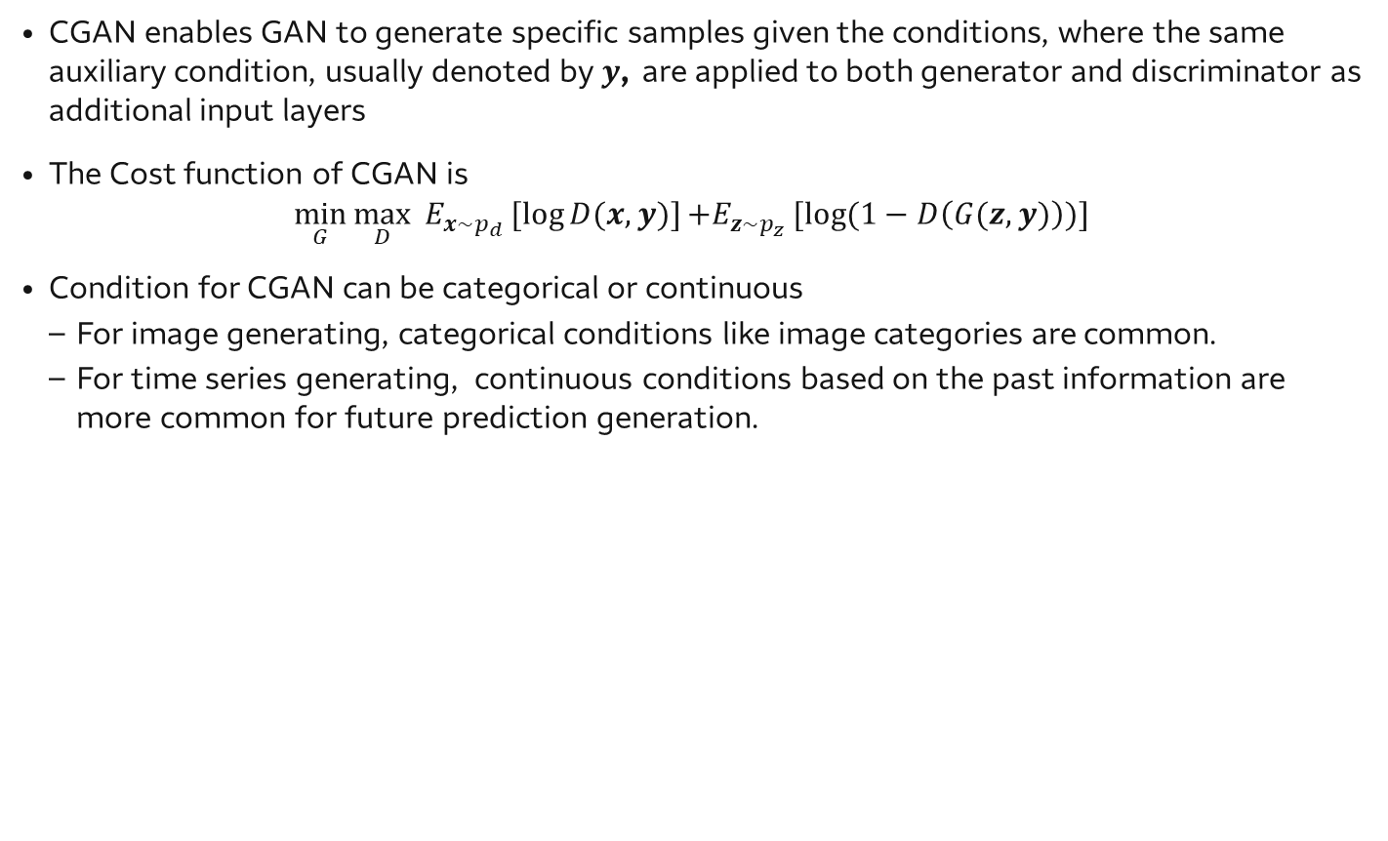
Conditional GAN (CGAN)
CGAN enables GAN to generate specific samples given the conditions, where the same auxiliary condition, usually denoted by$y$, are applied to both generator and discriminator as additional input layers
The Cost function of CGAN is
$$\min_{G}{\max_{D}{E_{x\sim p_{d}}[log{D(x,y)}]}}{+E_{z\sim p_{z}}[log{(1−D\left(G(z,y)\right))}] }$$
Condition for CGAN can be categorical or continuous
For image generating, categorical conditions like image categories are common.
For time series generating, continuous conditions based on the past information are more common for future prediction generation.
Generated MNIST digits, each row conditioned on one label (0,1,..., 9)

Slide 14
Insights into GAN

Slide 15
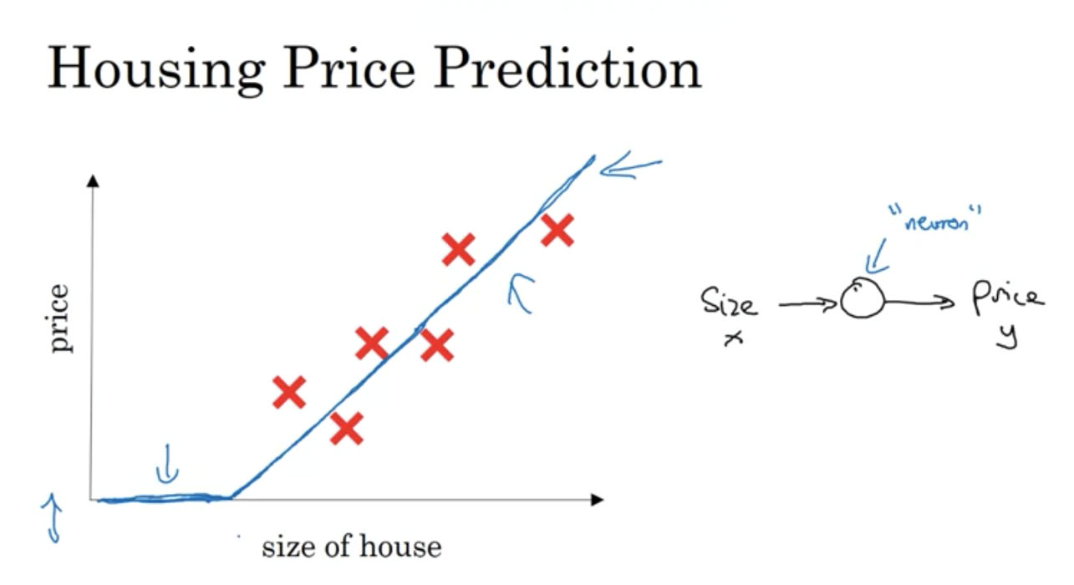
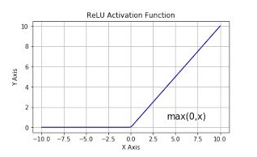
Understand Neural Network Model as a Non-linear Mapping
Linear mapping -> nonlinear mapping

Slide 16
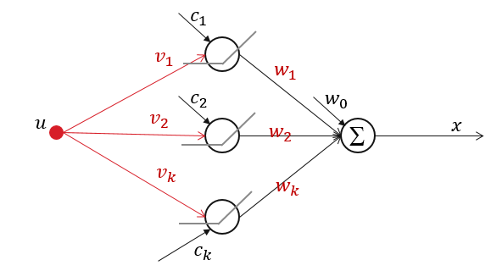
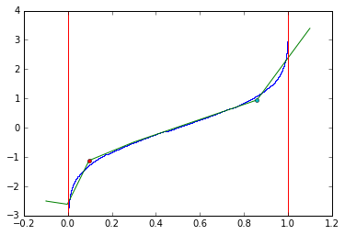
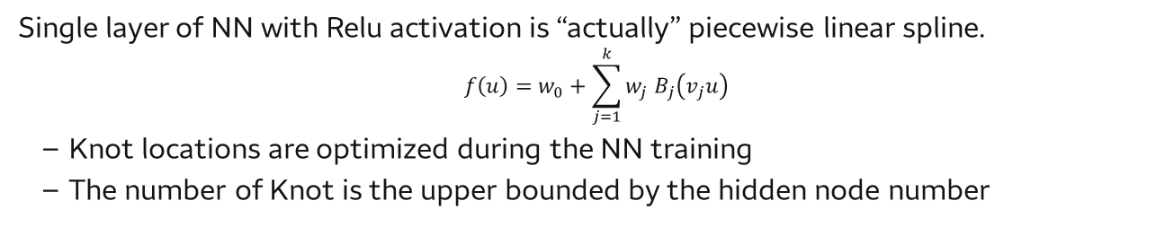
Understand Neural Network Model as a Non-linear Mapping
Single layer of NN with Relu activation is “actually” piecewise linear spline.
$$f\left(u\right)=w_{0}+\sum_{j=1}^{k}{{w_{j} B}_{j}\left(v_{j}u\right)}$$
Knot locations are optimized during the NN training
The number of Knot is the upper bounded by the hidden node number
All neural networks models can be written as a composition of spline functions.
(Randall Balestiero and Richard Baraniuk. Mad Max: Affine Spline Insights into Deep Learning. arXiv preprint ArXiv:1805.06576v5, 2018 )

Slide 17
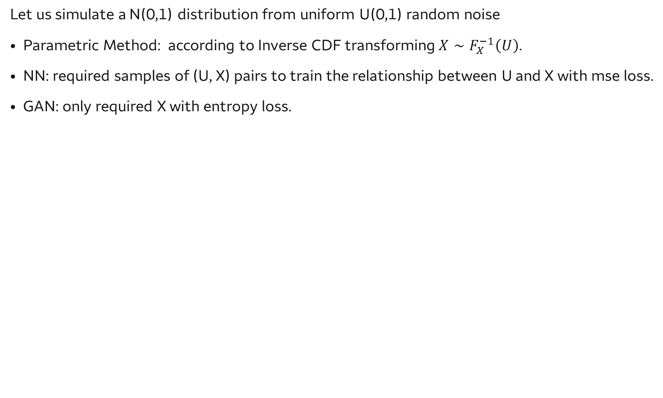
Understand Generator as a Non-linear mapping
Let us simulate a N(0,1) distribution from uniform U(0,1) random noise
Parametric Method: according to Inverse CDF transforming$X∼F_{X}^{−1}\left(U\right)$.
NN: required samples of (U, X) pairs to train the relationship between U and X with mse loss.
GAN: only required X with entropy loss.
1-layer with 7 nodes with single dimensional noise
In the following plots, the blue line is inverse CDF from U(0,1) (x-axis) to N(0, 1) (y-axis), and the green line is the spline approximation trained by GAN.

Slide 18
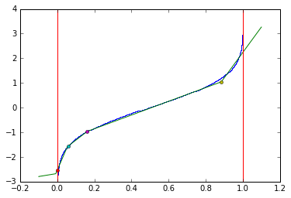
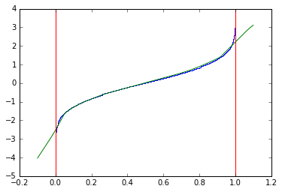
Understand Generator as a Non-linear mapping
In the following plots, the blue line is inverse CDF from U(0,1) (x-axis) to N(0, 1) (y-axis), and the green line is the spline approximation trained by GAN.
Left :1-layer with 7 nodes with single dimensional noise
Middle: 1-layer with 100 nodes with single dimensional noise
Right: 2-layer with 100*100 nodes with single dimensional noise
Note that: some nodes are collapses together.

Slide 19
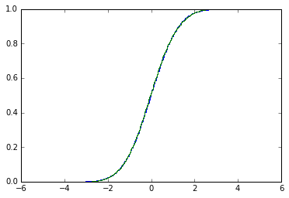
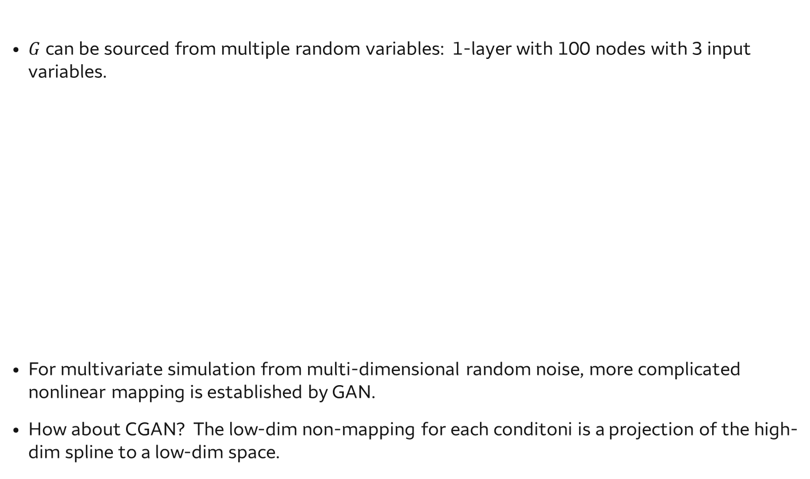
Understand Generator as a Non-linear mapping
$G$can be sourced from multiple random variables: 1-layer with 100 nodes with 3 input variables.
For multivariate simulation from multi-dimensional random noise, more complicated nonlinear mapping is established by GAN.
How about CGAN? The low-dim non-mapping for each conditoni is a projection of the high-dim spline to a low-dim space.

Slide 20
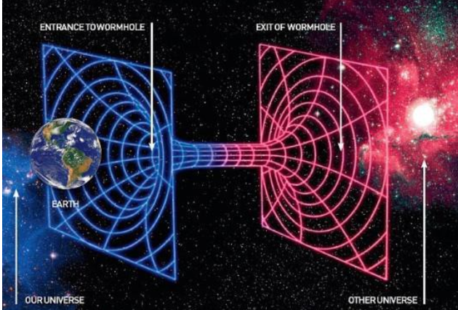
Travel in dimensions

Slide 21
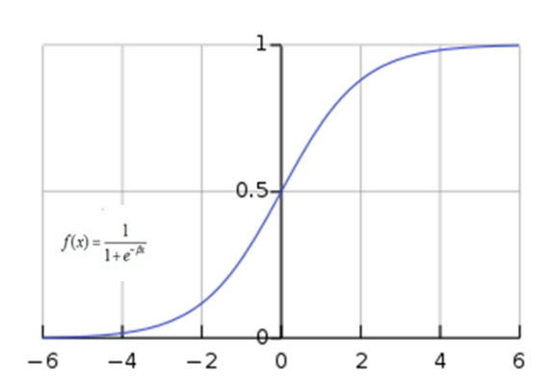
Understand Discriminator as a Non-linear mapping
Discriminator can be considered as a special logistic regression
Sigmoid activation function
Logit(B*X) -> Logit (Spline(X))

Slide 22
Computation for GAN

Slide 23
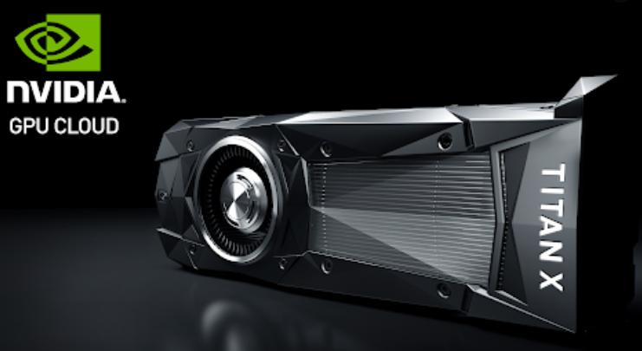
Computation for GAN

Slide 24
Computation for GAN
Keras backended by tensorflow 1
model = Sequential()
model.add(Dense(256, input_shape=noise_shape))
model.add(LeakyReLU(alpha=0.2))
Tensorflow 2, Keras API
model = tf.keras.models.Sequential()
model.add(tf.keras.Input(shape=(16,)))
model.add(tf.keras.layers.Dense(32, activation='relu'))
(3) PyTorch
self.dis_net.add_module('dis-linear-{}'.format(i+1), nn.Linear(input_dim, hidden_dim))
self.dis_net.add_module('dis-dropout-{}'.format(i+1), nn.Dropout(p=self.dropout))
self.dis_net.add_module('dis-LeakyRelu-{}'.format(i+1), nn.LeakyReLU(0.1))

Slide 25
Computation for GAN
TF1.0 Keras with linear layers
def build_generator(self):
noise_shape = (100,)
model = Sequential()
model.add(Dense(256, input_shape=noise_shape))
model.add(LeakyReLU(alpha=0.2))
model.add(Dense(512))
model.add(LeakyReLU(alpha=0.2))
model.add(Dense(1024))
model.add(LeakyReLU(alpha=0.2))
model.add(Dense(np.prod(self.img_shape), activation='linear'))
model.add(Reshape(self.img_shape))
model.summary()
noise = Input(shape=noise_shape)
img = model(noise)
return Model(noise, img)
def build_discriminator(self):
img_shape = (self.img_rows, self.img_cols)
model = Sequential()
model.add(Flatten(input_shape=img_shape))
model.add(Dense(512))
model.add(LeakyReLU(alpha=0.2))
model.add(Dense(256))
model.add(LeakyReLU(alpha=0.2))
model.add(Dense(1, activation='sigmoid'))
model.summary()
img = Input(shape=img_shape)
validity = model(img)
return Model(img, validity)

Slide 26
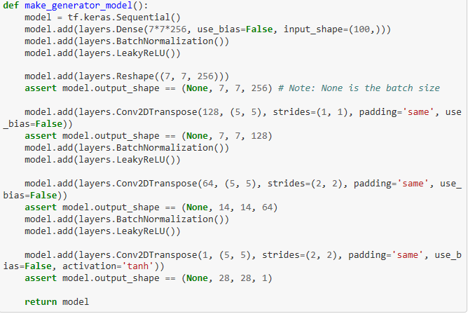
Computation for GAN
TF2.0 Keras API with complex layers

Slide 27
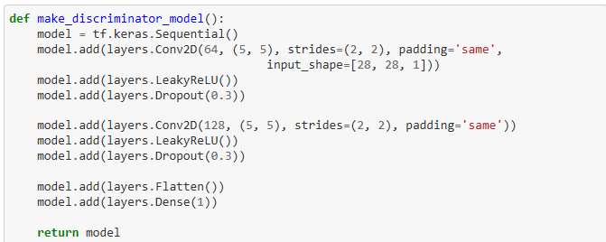
Computation for GAN
TF2.0 Keras API with complex layers

Slide 28
What happens when our computers get smarter than we are?
AlphaGo
https://www.youtube.com/watch?v=8tq1C8spV_g
What happens when our computers get smarter than we are?
https://www.ted.com/talks/nick_bostrom_what_happens_when_our_computers_get_smarter_than_we_are

Slide 29
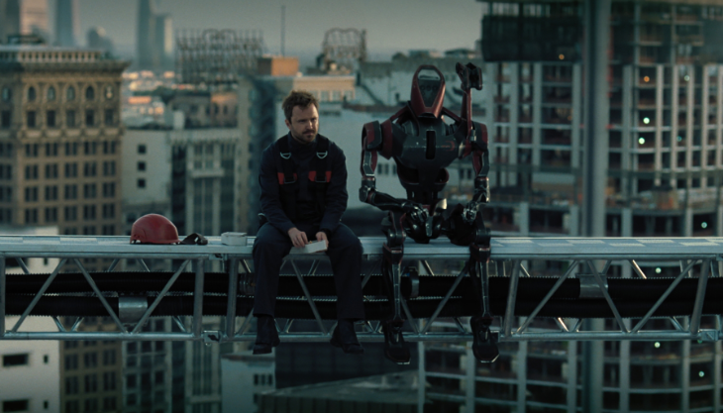
What happens when our computers get smarter than we are?

Slide 30
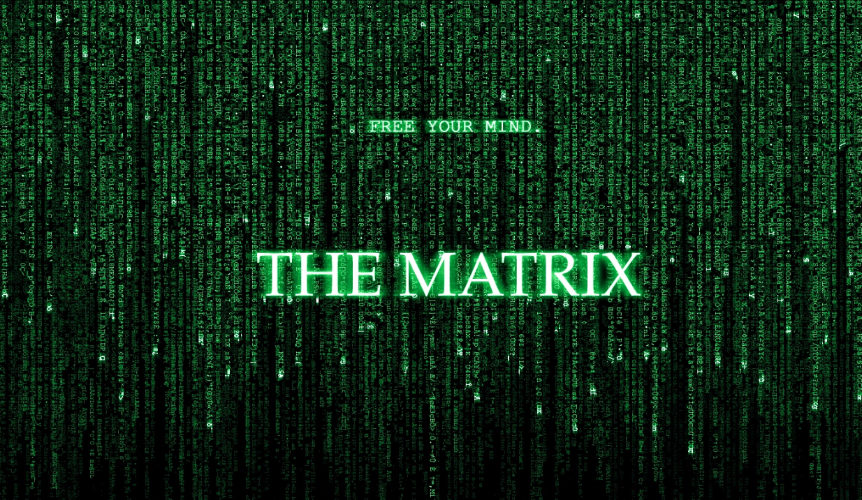
Potential Application?

